Slide 1
Introduction to
Grantham, Mayo, Van Otterloo & Co. LLC

Slide 2
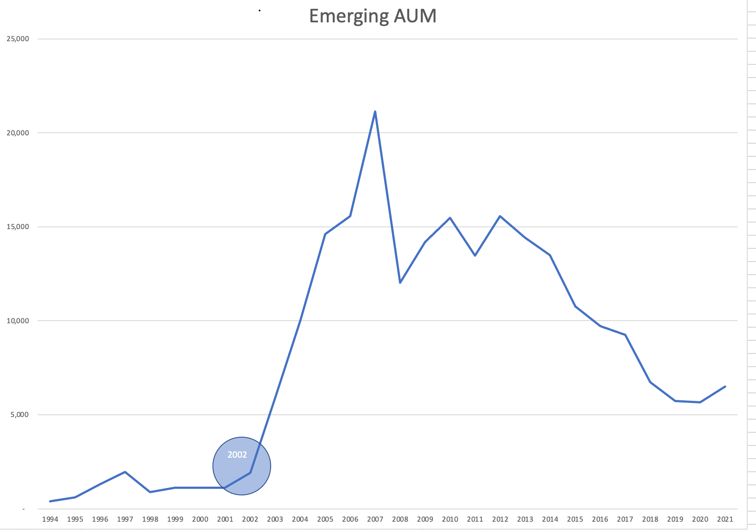

Slide 3
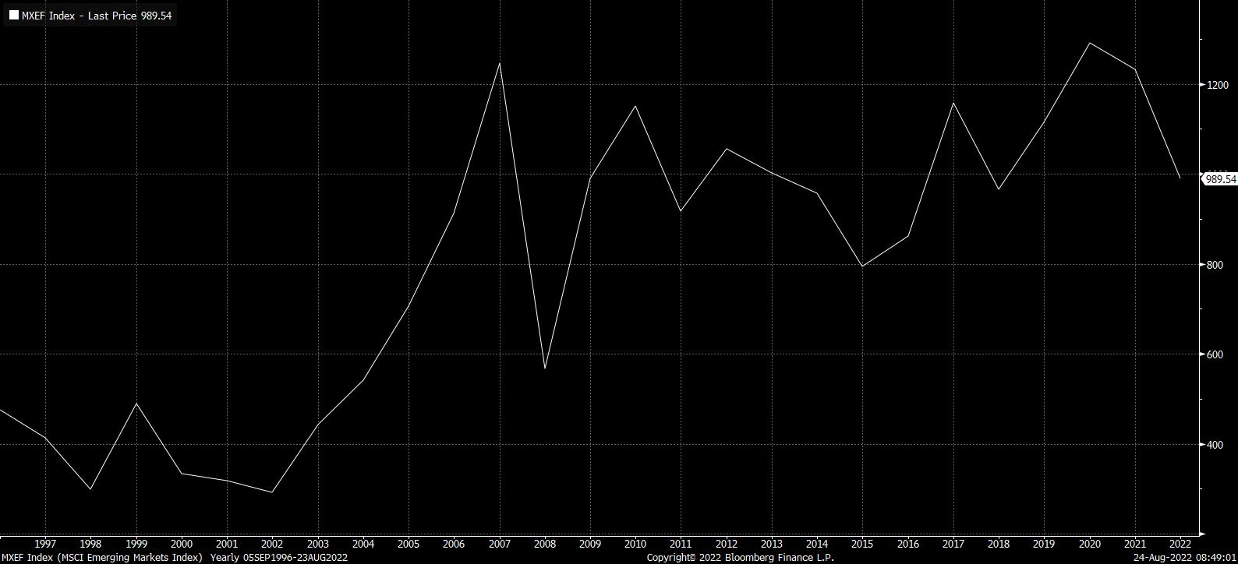
MSCI EM Index Return

Slide 4
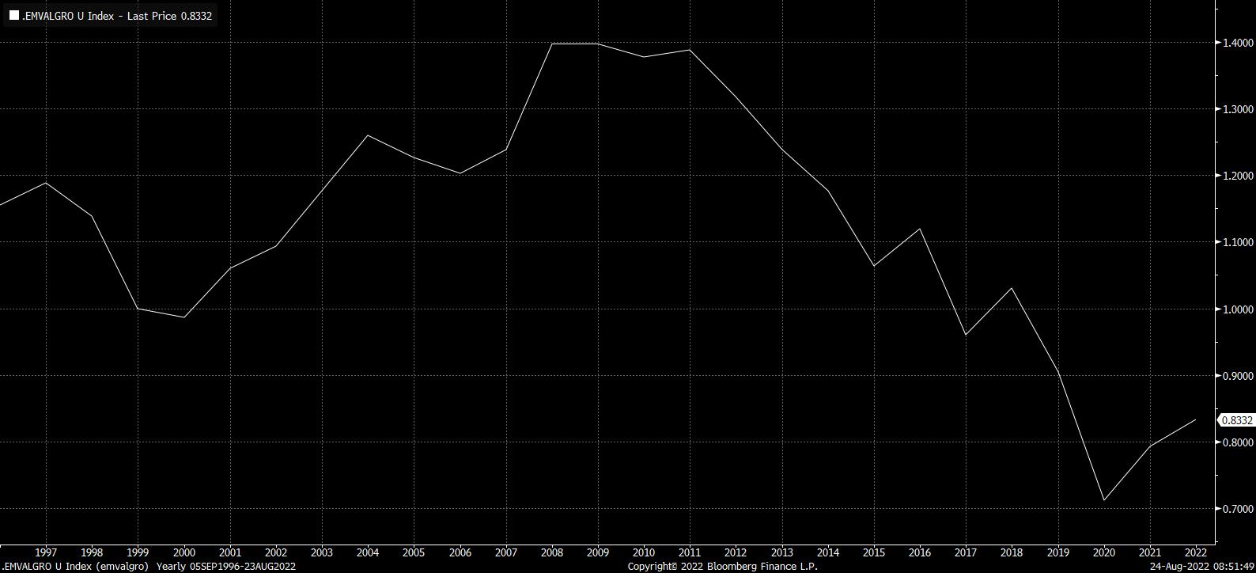
EM Value vs Growth

Slide 5
Grantham, Mayo, Van Otterloo & Co. LLC
Value Experience Independence Stability
London
San Francisco
Boston
PULL CURRENT EXHIBIT FROM INTRO BIBLE
Sydney
$22 Billion in assets under management
  $12 Billion: International Equities
  $7 Billion: U.S. Equities
  $3 Billion: Global Fixed Income
Notes:
As a member of our firm’s Management Committee, I would like to take a moment to introduce GMO to you.
We are a global independent money manager based in Boston with a key investment and client service center based here in California. We recognize many fine firms have been selected to present to you by the CalPERS Staff with the assistance of Wilshire Associates, each with their own unique attributes. We appreciated being included amongst such a group.
As a partnership solely focused on managing money, we believe four key characteristics define GMO:
Value: Philosophically, we believe that value is a powerful discipline for identifying mispriced securities and generating excess returns. Value is a characteristic common to every discipline we employ. We have proven our expertise in identifying mispriced securities using our valuation techniques for over 20 years.
Experience: GMO possess the good judgment that only comes from experience. Our people, processes, strategies, systems, business practices and service models have all been tested in many dynamic environments and have succeeded. It is a function of this experience that makes us confident that we can meet CalPERS expectations with respect to both your investment and service requirements.
Independence: As a firm 100% owned by its employees we control our own destiny and agenda. We are able to focus all of our collective efforts to fulfill our mission -> namely to be a focused asset manager. We continue to manage portfolios on behalf of institutional investors similar to CalPERS, and we are driven to produce superior investment results and service consistent with our clients’ objectives.
Stability: We have the means and record of attracting and retaining our team of professionals. Our mission is clear. Speaking on behalf of the GMO Mgt Committee; we as a firm recognize and appreciate the premium that your Investment Committee, the CalPERS Staff and Wilshire Associates place on stability. We have the ability to reinvest in our business across the board to ensure our mission is not compromised.
In our presentation, you will see that we have a page outlining your objectives. We state these in writing because we want to be held accountable for delivering these objectives. We want to be held accountable because we have significant confidence in our processes and people, and with that, let me allow Ann to introduce our International Equity management team.

Slide 6
Emerging Markets Equity
Organization
GMO is a privately held company that was founded in 1977. The members share a belief in value investing. We believe that the best way to bring a quality product to our clients is through a firm where we can control growth, attract great talent and directly share the rewards of our success.
Grantham, Mayo, Van Otterloo & Co. LLC
U.S. Active
Quantitative
Int’l. Active
Emerging Markets
Portfolio Management
Arjun Divecha
Fund Manager
Amit Bhartia, CFA
Portfolio Manager
Sam Wilderman, CFA
Portfolio Manager
Committed to investment research and performance
Exceptionally low turnover of investment personnel
81 investment professionals
More than 200 associates worldwide
$22 billion in assets under management:
  $11 billion in foreign equities
  $8 billion in U.S. equities
  $3 billion in fixed income
Quantitative Investment Research
Jonathan Calvert
Cliff Gong
Tom Hancock, Ph.D.
Ben Inker, CFA
Chuck Joyce
Portfolio Trading & Operations
Christine Ferrara
Melanie Nason
Caroline Norgeot
Quantitative Research Team
(62 Research Analysts)
Emerging Markets

Slide 7
We Have Added Value Over Every
Time Period Through December 31, 2001
Note: Past performance does not guarantee future results. Performance presented does not include management and other fees; if included, performance would be lower.
As of 12/31/01
Emerging Markets

Slide 8
Core Beliefs and Competitive Advantages

Slide 9
Emerging Equity
Core Beliefs and Competitive Advantages
GMO seeks to outperform the IFC Investable Emerging Markets Index by 4% per year, net of fees, over a market cycle.
Quantitative Approach
Disciplined implementation of our quantitative process allows us to
consistently capture alpha
We believe that “value” wins in the long run
Disciplined risk management allows us to maximize intentional bets while minimizing incidental exposures
Our research and experience indicate that country exposure is the primary driver of performance. We focus approximately 80% of our effort on adding value at this level
We are able to attract and retain highly talented people. Our personnel
turnover is among the lowest in the investment industry
Value Orientation
Controlled Risk
Country Emphasis
100% Employee Ownership
Emerging Markets

Slide 10
Why Quantitative?
Power
The ability to process more information, faster
Discipline
Emotion is the enemy
Confidence
Backtesting helps us know what really works
Quantitative Approach
Value Orientation
Controlled Risk
Country Emphasis
100% Employee Ownership
Emerging Markets

Slide 11
Emerging Equity
“Value Wins in the Long Run”
Value works in the long run. The more inefficient the asset class, the better value does.
Notes: Emerging Markets data starts in 1987, International data starts in 1975 and United States data starts in 1960. Portfolios rebalanced annually.
Quantitative Approach
Value Orientation
Controlled Risk
Country Emphasis
100% Employee Ownership
As of 12/31/01
Emerging Markets

Slide 12
Emerging Equity
“Value Wins in the Long Run”
Value works in the long run. The more inefficient the asset class, the better value does.
Notes: Emerging Markets data starts in 1987, International data starts in 1975 and United States data starts in 1960. Portfolios rebalanced annually.
Quantitative Approach
Value Orientation
Controlled Risk
Country Emphasis
100% Employee Ownership
As of 12/31/01
Emerging Markets

Slide 13
Emerging Equity
GMO Risk Control Methodology
Reducing exposure to
incidental factors leads
to much more consistent returns.
Raw Portfolio
Risk Controlled Portfolio
Risk
Control
Quantitative Approach
Value Orientation
Controlled Risk
Country Emphasis
100% Employee Ownership
Emerging Markets

Slide 14
Emerging Equity
GMO research indicates that while sector emphasis has grown in importance in the developed markets, country selection remains paramount in the Emerging Markets.
Reasons for this disparity include: lower economic integration; greater endogenous risks; and the power of local investors.
Quantitative Approach
Value Orientation
Controlled Risk
Country Emphasis
100% Employee Ownership
As of 12/31/01
Emerging Markets

Slide 15
GMO’s Quantitative Investment Process

Slide 16
Emerging Equity
Process
Country
Experience and research have taught us that a consistent
blend of several key factors
leads to high risk-adjusted returns.
Judgment plays a limited and carefully measured role.
Our emphasis is on value
at the country and stock
levels.
Optimizer
Emerging Markets Fund
Stock
Optimizer
Emerging Markets

Slide 17
Emerging Equity
Country Allocation
“Robustness”
We use several sub-models within each of our disciplines to maximize the power and consistency of their contributions.
“Parsimony”
We construct models that are simple, thoughtful and justifiable.
Emerging Markets

Slide 18
Mexico Country Selection
Value
Momentum
Reversal
Macroeconomic
Judgment
Through 1/2/02
Emerging Markets

Slide 19
Emerging Equity
History Doesn’t Repeat Itself…
Note: Month 0 denotes January 1995 for Mexico.
Emerging Markets

Slide 20
Emerging Equity
…But It Rhymes
Note: Month 0 denotes January 1995 for Mexico, January 1998 for Korea and October 1997 for Thailand and Indonesia.
Emerging Markets

Slide 21
Emerging Equity
Currency Vulnerability Framework
Low Risk
Danger Zone
High Risk
Emerging Markets

Slide 22
Emerging Equity
Mexico Currency Situation
January 1990 - December 2001
As of 12/31/01
Emerging Markets

Slide 23
Emerging Equity
Currency Vulnerability: Improving Fundamentals
July 1997
December 2000
Low Risk
Low Risk
High Risk
High Risk
Emerging Markets

Slide 24
Currency Situation
As of January 1, 2002
As of 1/1/02
Emerging Markets

Slide 25
Stock Selection

Slide 26
Emerging Markets Investment Process
Stock Selection
2,400+ Emerging Markets Companies
Robust Value
(70%)
Momentum
(30%)
GMO Proprietary
Value Model
Earnings Revisions
Price
Emerging Markets

Slide 27
Emerging Markets Stock Selection
0.7 Value / 0.3 Momentum
Return Risk
Value: 5.6% 4.3%
Momentum: 4.8% 4.4%
Blended: 5.4% 3.2%
Emerging Markets

Slide 28
Stock Selection Example
Emerging Markets

Slide 29
Risk Control and Portfolio Construction

Slide 30
Emerging Markets
GMO considers risk control a critical component in managing a core Emerging Markets discipline.
We have developed a proprietary risk model which helps us to accentuate intended exposures while reducing unintended bets.
Single Factor Multi-Factor
Alpha 3.11% 5.54%
Tracking Error 4.59% 3.78%
Information Ratio 0.68 1.47
As of 12/31/01
Emerging Markets

Slide 31
Emerging Equity
GMO Risk Control Methodology
Why not just use BARRA software?
We have a different philosophy about the consideration of risk factors.
Emerging Markets

Slide 32
Emerging Markets
Portfolio Construction
Alphas
Transaction
Costs
Cash
Flow
Current
Portfolio
Weights
Quadratic
Optimizer
New
Portfolio
Weights
Risk
Aversion
Market
Weights
Trade
List
Objective Function:
(Maximize) Utility = Alpha
- Risk (net of benchmark)
- Transaction Costs (quadratic)
Emerging Markets

Slide 33
Portfolio Positioning
GMO Emerging Markets Strategy
As of 12/31/01
Emerging Markets

Slide 34
Country Allocation Grid – January 2002
Note: Allocations will vary over time.
Emerging Markets

Slide 35
Value and Small Stocks are
Extraordinarily Positioned for Outperformance
16%
As of 12/31/01
Emerging Markets

Slide 36
Emerging Equity
Portfolio Characteristics as of December 31, 2001
Cap Size Allocation
Regional Allocation
($1.3B and
Below)
($1.3B-$3.9B)
($3.9B-$10.9B)
($10.9B-$34.9B)
($34.9B and Above)
Valuation Measures
Note: Portfolio characteristics will vary over time.
Emerging Markets

Slide 37
Performance

Slide 38
Emerging Markets Performance
Frank Russell Company Universe of Emerging Markets Equity Managers
5th Percentile
25th Percentile
GMO
Median Manager
75th Percentile
95th Percentile
GMO
GMO
GMO
¹ Inception date: 12/9/93.
Universe source: Frank Russell Company. Returns for all managers are gross of fees. Performance represents past performance and is not indicative of future results. Data as of 9/30/01.
Emerging Markets

Slide 39
Emerging Equity
Performance Attribution Analysis
Period Ending December 31, 2001
¹ Inception date: 12/9/93.
Notes: Performance data quoted represents past performance. The investment return and principle value of an investment will fluctuate so that an investor's shares, when redeemed, may be worth more or less than their original cost. Performance does not include advisory or other fees; if included, performance would be lower.
Returns are gross of fees.
Emerging Markets

Slide 40
Representative Clients
PULL CURRENT EXHIBIT FROM APPENDIX BIBLE
Note: Clients listed here were chosen as generally representative of the types of clients that comprise GMO’s primary client base (Pension Funds, Educational Endowments, Foundations and International Organizations) and were not chosen based on performance-related criteria. It is not known whether these clients approve or disapprove of the adviser or the advisory services provided.
Emerging Markets
As of 3/01

Slide 41
Emerging Equity
Summary
Quant works and GMO is a pioneer in using disciplined, quantitative research.
Our dedicated Emerging Markets team leverages the research capabilities of GMO’s global research platform.
We overweight countries that are:
  Cheap (low price/earnings, low price/book, etc.).
  Less vulnerable to currency shocks.
  Set to surprise conventional wisdom.
We employ a strong risk control discipline
We have exceeded our performance objectives
Emerging Markets

Slide 42
Supplemental Materials

Slide 43
Don’t Fire Until You See the Whites of Their Eyes
Emerging Markets

Slide 44
Emerging Equity
Economic Risk Regresses Quickly, But Not Fully, Valuations Follow
Source: Political Risk Services.
Emerging Markets

Slide 45
Emerging Equity
Growth Regresses to Trend Quickly and Fully
Emerging Markets

Slide 46
Emerging Equity
Adjusted Price/Earnings
Get to the heart of a dividend discount model without all the dangers of a dividend discount model.
  Start with historical P/E ratio.
  Grow earnings by predicted annual GDP Growth (over three years).
  Adjust for country economic risk (from Political Risk Services).
Emerging Markets

Slide 47
Emerging Equity
Simulation of Adjusted P/E Model
Some Vital Statistics
Emerging Markets
As of 12/31/99

Slide 48
Emerging Equity
Price Momentum
Emerging Markets
As of 3/00

Slide 49
Emerging Equity
Value Burns Slowly: Price/Book Return
Emerging Markets

Slide 50
Emerging Equity
Momentum Burns Quickly: Acceleration Return
Emerging Markets

Slide 51
Capsule Biographies: Emerging Equity
Arjun Divecha Mr. Divecha is based in Berkeley, California and is responsible for managing the GMO Emerging Markets Fund, the GMO Evolving Countries Fund and the GMO Asia Fund. Prior to his affiliation with GMO in 1993, he spent 12 years at BARRA directing software development, marketing, client service and emerging markets research and development. Mr. Divecha holds a Bachelor of Technology in Aeronautical Engineering from the Indian Institute of Technology, Bombay and an M.B.A. in Finance from Cornell University.
Amit Bhartia Mr. Bhartia is engaged in portfolio management for the GMO Emerging Markets Fund. Prior to joining GMO in 1995, he worked as an investment advisor in India. Mr. Bhartia earned a Bachelor of Engineering at the University of Bombay and an M.B.A. at the Institute for Technology and Management in Bombay. He is a Chartered Financial Analyst.
Clifford Gong Mr. Gong is engaged in research and analysis for the GMO Emerging Markets Fund. Prior to joining GMO in 1998, he was a quantitative research analyst at BARRA, Inc. Mr. Gong earned his B.A. in Computer Information Systems from the University of California, Santa Cruz.
Sam Wilderman Mr. Wilderman is based in Berkeley, California and is responsible for portfolio management and research for the GMO Emerging Markets Fund, the GMO Evolving Countries Fund and the GMO Asia Fund. He joined GMO in 1996 following the completion of his B.A. in Economics from Yale University. Mr. Wilderman is a Chartered Financial Analyst.
Emerging Markets

Slide 52
Capsule Biographies: Emerging Equity
Christine Ferrara Ms. Ferrara is the Investment Division Controller for GMO’s Emerging Markets Group. Prior to joining GMO in 1993, she worked as an operations supervisor at Boston Overseas Investors. Ms. Ferrara received her B.A. in Psychology from the University of New Hampshire.
Melanie Nason Ms. Nason is part of the administrative team that supports GMO’s Emerging Markets Funds. Prior to joining GMO in 1996, she was employed by State Street Bank & Trust Co. in the Mutual Fund Services Division as a fund accountant. Ms. Nason earned her B.S. in Finance from Bentley College.
Caroline Norgeot Ms. Norgeot works on trading support for GMO’s Emerging Markets Funds. Prior to joining GMO in 1996, she was employed at State Street Bank & Trust Co. as a senior mutual fund accountant. Ms. Norgeot received her B.A. in Mathematics from Lynchburg College in Virginia.
Luz Perla Ms. Perla is a member of GMO’s Investments Control Group. She joined GMO following the completion of her Associate degree in Business Management at Mitchell College.
Emerging Markets

Slide 53
GMO
Boston Ÿ London Ÿ San Francisco Ÿ Sydney
Emerging Equities
November 2001
Portfolio Review
Presenter(s)

Slide 54
GMO
Boston Ÿ London Ÿ San Francisco Ÿ Sydney
Grantham, Mayo, Van Otterloo & Co. LLC
40 Rowes Wharf
Boston, Massachusetts 02110
(617) 346-7500 Ÿ www.gmo.com

Slide 55
Emerging Markets Strategy
Performance, Gross of Fees as of 12/31/01
Annualized
Gross Returns
Value Added
Performance data quoted represents past performance and is not indicative of future performance. Performance reflects the reinvestment of dividends and interest. Performance does not include advisory or other fees; if included, performance would be lower.
There are risks associated with investing in a fund of this type that invests in securities of foreign countries, such as erratic market conditions, economic and political instability, and fluctuations in currency exchange rates.

Slide 56
Emerging Markets
Top Holdings As of December 31, 2001
Number of Holdings: 418
Portfolio holdings are subject to change and should not be considered
a recommendation to buy individual securities.

